Slide 1


Project
Olist Store Analysis

Slide 2
Project team members
Project Mentor
1.N.Srilakshmi
2.P.Lalith
3.P.Sharmila Sai
4.Shivam
5.Ashok Dnyaneshwar
6.Poonam Swapnil
7.Sagar Ravindra

Slide 3


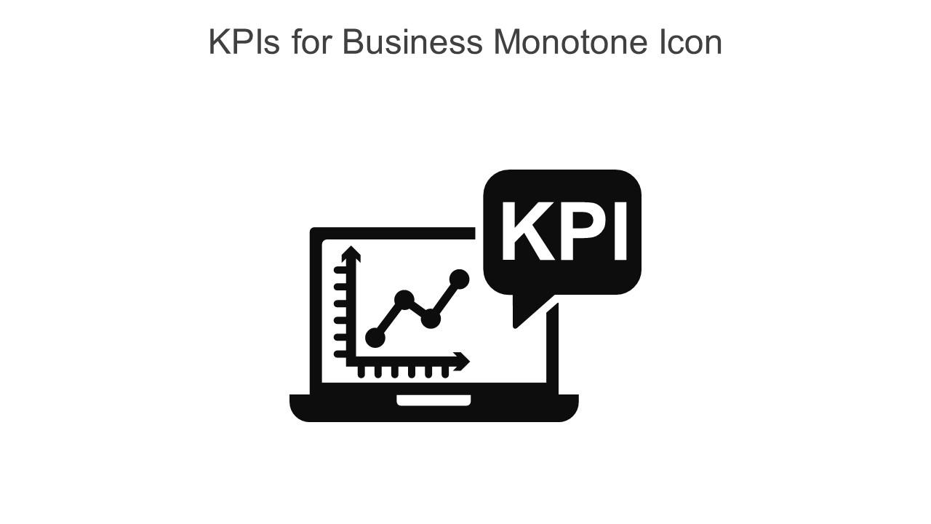







Tableau
Introduction
KPI’s
My SQL
Connections
Insights
Excel
Challenges
Summary
Power BI

Slide 4
Olist store is an online E-commerce site for sellers.It connect sellers to various marketplaces,allowing businesses to list their products for sale online in the across Brazil.
In this presentation,we will analyse the Brazilian E-commerce dataset by olist,and create a dashboard to explore about data in easy way and overall customer satisfaction and evaluating the company store performance.

Slide 5
AREAS OF GROWTH
 | B2B | Supply chain | ROI | E-commerce
Q1 | 4.5 | 2.3 | 1.7 | 5.0
Q2 | 3.2 | 5.1 | 4.4 | 3.0
Q3 | 2.1 | 1.7 | 2.5 | 2.8
Q4 | 4.5 | 2.2 | 1.7 | 7.0

Slide 6
BUSINESS OPPORTUNITIES ARE LIKE BUSES. THERE'S ALWAYS ANOTHER ONE COMING.
“
”
Richard Branson

Slide 7




MEET OUR TEAM
TAKUMA HAYASHI
MIRJAM NILSSON
FLORA BERGGREN​
RAJESH SANTOSHI​
President
Chief Executive Officer
Chief Operations Officer
VP Marketing

Slide 8








MEET OUR Extended TEAM
TAKUMA HAYASHI
MIRJAM NILSSON
FLORA BERGGREN​
RAJESH SANTOSHI​
President
Chief Executive Officer
Chief Operations Officer
VP Marketing
GRAHAM BARNES
ROWAN MURPHY
ELIZABETH MOORE
ROBIN KLINE
VP Product
SEO Strategist
Product Designer
Content Developer

Slide 9





PLAN FOR PRODUCT LAUNCH
PLANNING
MARKETING
DESIGN
STRATEGY
LAUNCH
Synergize scalable e-commerce
Disseminate standardized metrics
Coordinate e- business applications
Foster holistically superior methodologies
Deploy strategic networks with compelling e- business needs

Slide 10
TIMELINE
SEP 20XX
NOV 20XX
JAN 20XX
MAR 20XX
MAY 20XX
Synergize scalable e-commerce
Disseminate standardized metrics
Coordinate e- business applications
Foster holistically superior methodologies
Deploy strategic networks with compelling e- business needs

Slide 11
AREAS OF FOCUS
B2B MARKET SCENARIOS
CLOUD-BASED OPPORTUNITIES
Develop winning strategies to keep ahead of the competition
Capitalize on low-hanging fruit to identify a ballpark value
Visualize customer directed convergence
Iterative approaches to corporate strategy
Establish a management framework from the inside

Slide 12



HOW WE GET THERE
ROI
NICHE MARKETS
SUPPLY CHAINS
Envision multimedia-based expertise and cross-media growth strategies
Visualize quality intellectual capital
Engage worldwide methodologies with web-enabled technologies
Pursue scalable customer service through sustainable strategies
Engage top-line web services with cutting-edge deliverables
Cultivate one-to-one customer service with robust ideas
Maximize timely deliverables for real-time schemas

Slide 13
SUMMARY
At Contoso, we believe in giving 110%. By using our next-generation data architecture, we help organizations virtually manage agile workflows. We thrive because of our market knowledge and great team behind our product. As our CEO says, "Efficiencies will come from proactively transforming how we do business."

Slide 14
THANK YOU
Mirjam Nilsson​
mirjam@contoso.com
www.contoso.com

